Slide 1
Continuing my friend’s talk… Let’s connect the dots and see what we have understood so far...
No ownership for any image

Slide 2
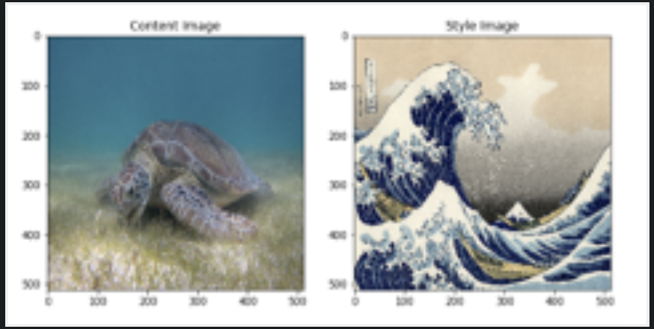
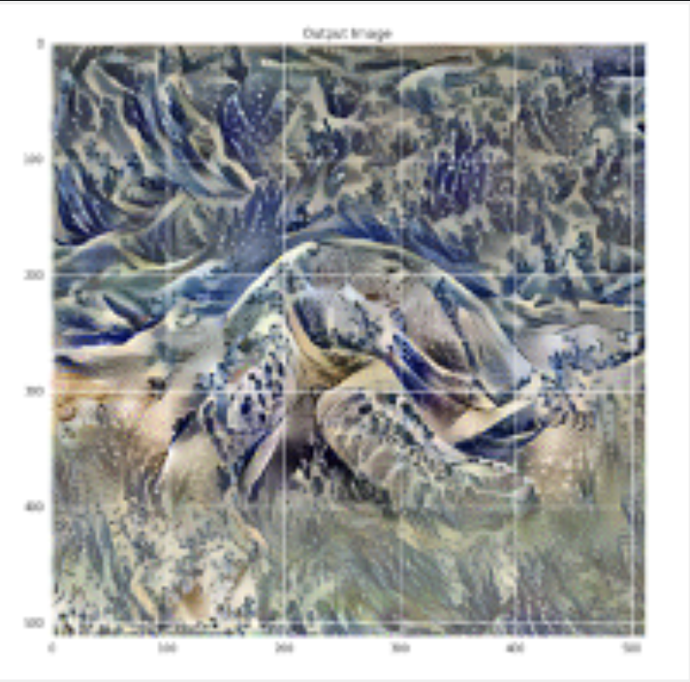
What we have learned so far...
Style Transfer
Disentanglement
Interpolation

Slide 3
Claims:
Principle Idea:
Separating the latent factors from compact code.
Interpolation and Disentanglement between features
Reduce the workload of generator.
Generator sees a processed input.
Directly controlling the image features.

Slide 4
Why Entanglement?
To overcome entanglement:
Previous work mainly focussed to match the generated image to be as close as ground truth. The features are learned directly from the image.
This brings unavoidable constraints and features gets entangled to one another.
Break the correlation which is developed inherently and learn a compact code which is constant.
Allow disentanglement.

Slide 5
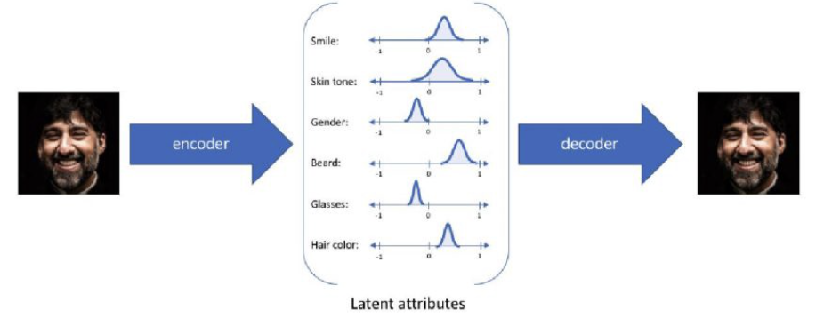
How entanglement gets developed…
Recall what we have studied in class.
Gr and Dr models
Pr(Observation) = Pr (Synthetic Observation)
Nash Equilibrium
Same with VAE (matching Probabilities)
This is where features gets entangled with each other

Slide 6
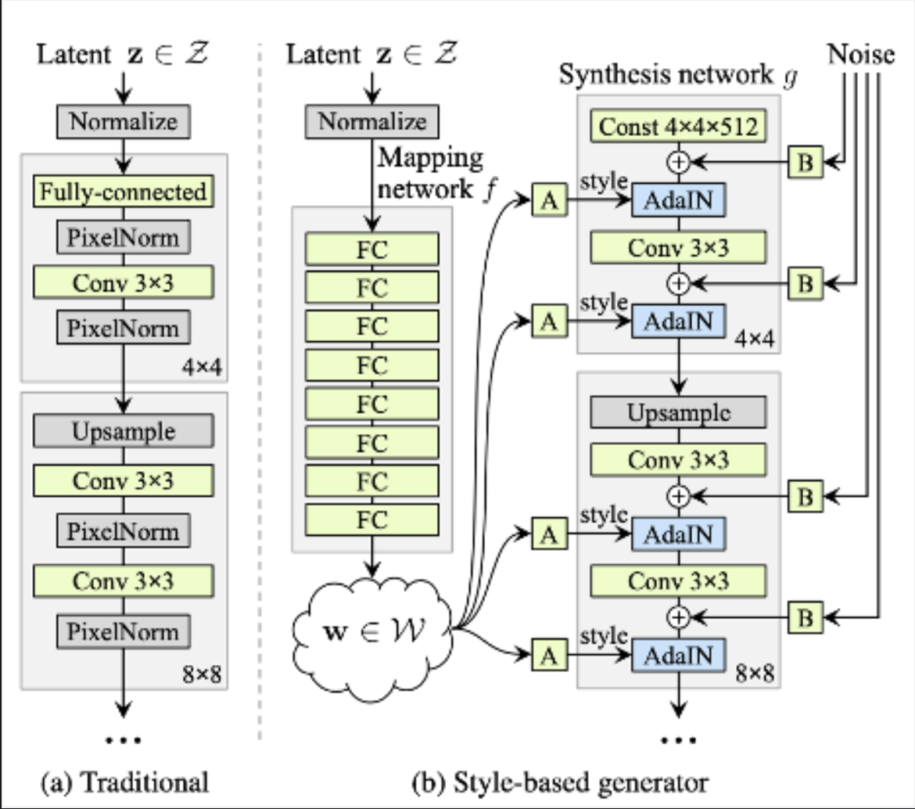
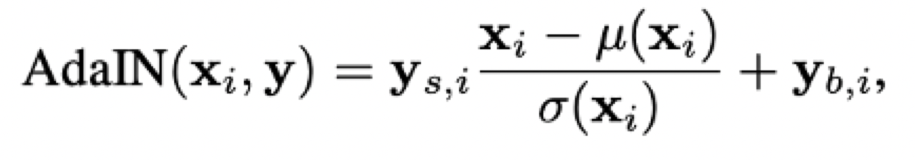
Quick relook to architecture and Properties:
mapping network is introduced in the Style Gan which extracts the features already for the generator.
latent vector W which is also called as intermediate controls generator with Adaptive Instance Normalisation

Slide 7
A quick comparison with ProGAN:
Demerits of ProGAN:
Improvement is StyleGAN...
Quality of Generated Images
How ProGan works?
Why not ProGAN?
attempt to tweak anything changes the whole distribution of the image quality
Do not learn any face specific features and Features are learned as if it is mugging up the information.

Slide 8
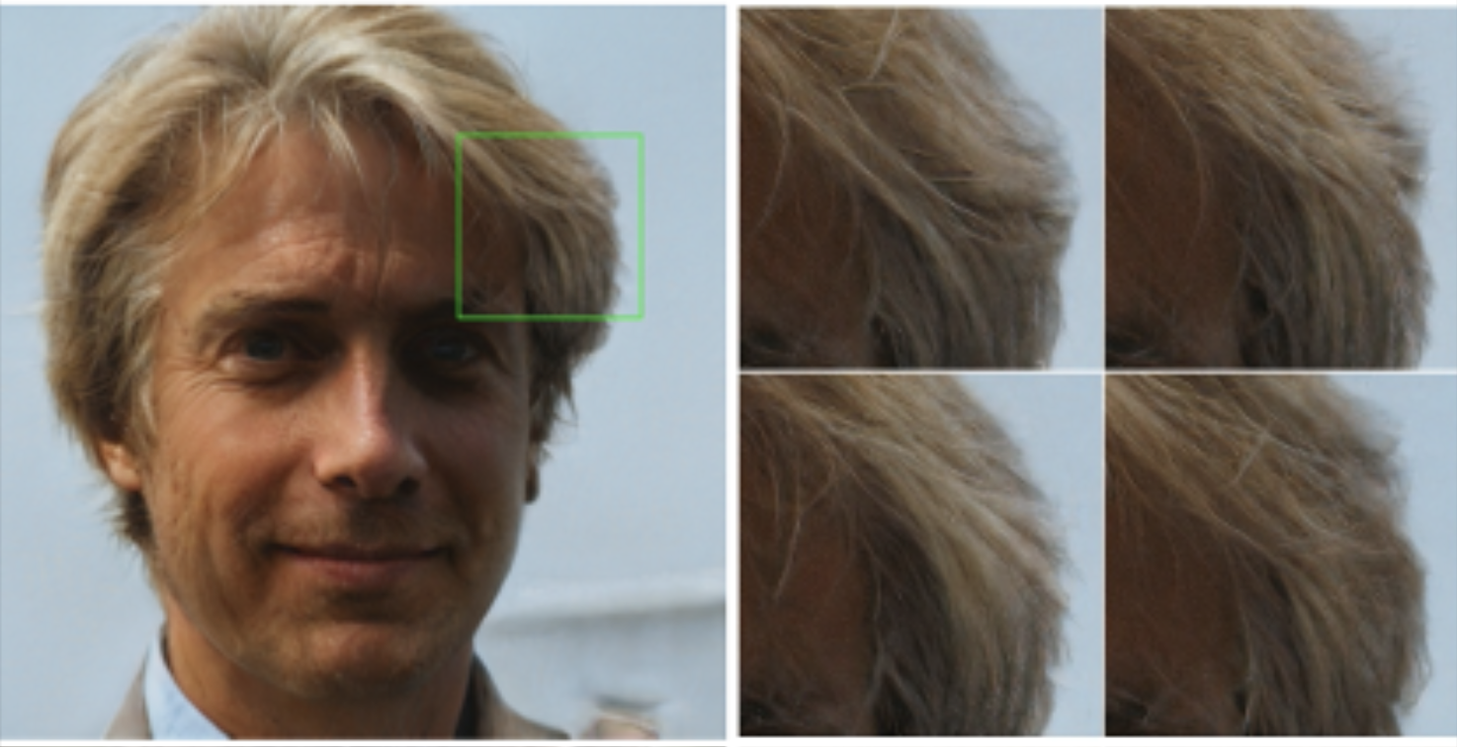
Further Improvements:
This created amazing results where a single image is released from two types of latent codes w1 and w2 from z1 and z2.
Style Mixing
Stochastic Variation
Adding per pixel noise will help in better understanding of the minute textures in the images
Prevents the network to memorise the features that are correlated
https://youtu.be/kSLJriaOumA

Slide 9
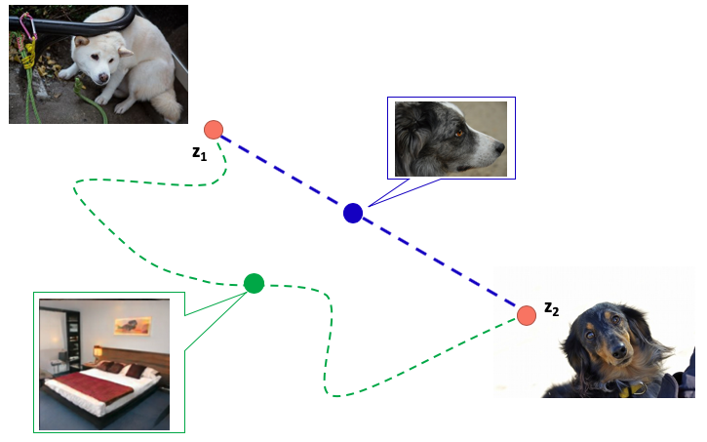
Disentanglement Studies:
it is true that if we had latent codes of each of the face features we would be able to control the features in the image and come up with a completely different representation
Perceptual Path Length
Linear Separability (Known already)
Perceptual Path Length
This will find the distance between feature maps visually. If separating the images far off and we observe a drastic change, this means the feature maps are entangled. Suppose removing the hair feature removes ears also, then we need to take care of it as removing hair shall not remove ears.

Slide 10
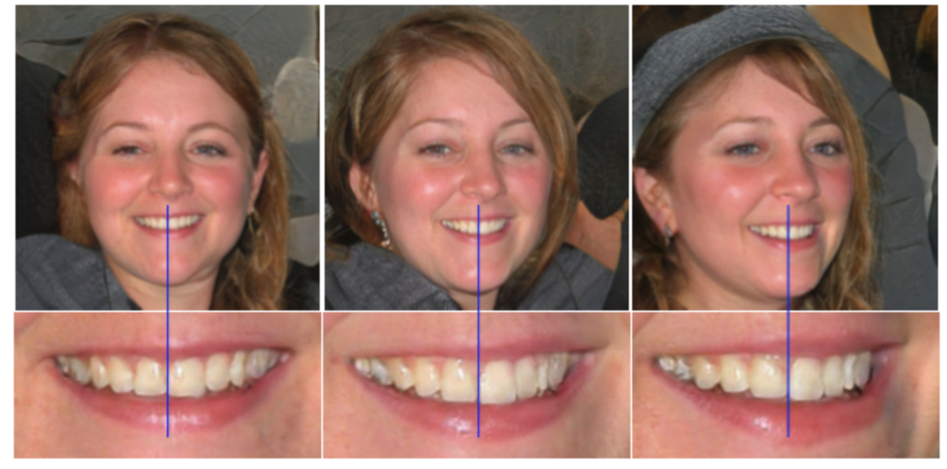
Conclusion and Misc. Takeouts:
StyleGAN Allows a control over the features in the image.
Major changes from previous tools is AdaIN and Mapping Network.
Advantages over ProGAN : Now you can easily manipulate entangled features. High quality and realistic images are generated.
Limitation: Check for the blue line in the image. Smile is not changing wrt the Face Movement

Slide 11
If time permits:
Conditional GAN (Exploiting the given labels and preserving class identities in early stages) | These GANs use extra label information and result in better quality images and are able to control how generated images will look. cGANs learn to produce better images by exploiting the information fed to the model.
Cycle GAN (For unpiared data) | CycleGAN is an extension to the GAN for image-to-image translation without paired image data. That means that examples of the target image are not required as is the case with conditional GANs. This we have briefly covered in class
PROGAN (Improving images progressively and increasing depth of GANS) | PROGan is a change to the architecture and training of GAN models that involves progressively increasing the model depth during the training process. starting from a low resolution, we add new layers that model increasingly fine details as training progresses.
StyleGAN | (Idea is to grab features from latent code and reducing the load on generator, which now focuses on constant latent code)

Slide 12
StyleGAN2. This article explores changes made in… | by Connor Shorten | Towards Data Science
https://towardsdatascience.com/stylegan2-ace6d3da405d
Which Face is Real? Applying StyleGAN to Create Fake People - Exxact
https://blog.exxactcorp.com/which-face-is-real-applying-stylegan-to-create-fake-people/
From GAN basic to StyleGAN2. This post describes GAN basic… | by Akihiro FUJII | Analytics Vidhya | Medium
https://medium.com/analytics-vidhya/from-gan-basic-to-stylegan2-680add7abe82
Can anyone inform me please about the advantages and limitations of Generative Adversarial Networks (GANs) ?
https://www.researchgate.net/post/Can-anyone-inform-me-please-about-the-advantages-and-limitations-of-Generative-Adversarial-Networks-GANs
StyleGAN: Use machine learning to generate and customize realistic images | by Jamshed Khan | Heartbeat
https://heartbeat.fritz.ai/stylegans-use-machine-learning-to-generate-and-customize-realistic-images-c943388dc672
Which Face is Real?
https://www.kdnuggets.com/2019/04/which-face-real-stylegan.html#:~:text=Generative%20models%20have%20a%20limitation,the%20differences%20in%20the%20photographs.
Introduction to Generative Adversarial Networks (GANs): Types, and Applications, and Implementation | by Derrick Mwiti | Heartbeat
https://heartbeat.fritz.ai/introduction-to-generative-adversarial-networks-gans-35ef44f21193
6 GAN Architectures You Really Should Know - neptune.ai
https://neptune.ai/blog/6-gan-architectures
3 different types of generative adversarial networks (GANs) and how they work | Packt Hub
https://hub.packtpub.com/3-different-types-of-generative-adversarial-networks-gans-and-how-they-work/
GANs vs. Autoencoders: Comparison of Deep Generative Models | by Matthew Stewart, PhD Researcher | Towards Data Science
https://towardsdatascience.com/gans-vs-autoencoders-comparison-of-deep-generative-models-985cf15936ea
[StyleGAN] A Style-Based Generator Architecture for GANs, part 1 (algorithm review) | TDLS - YouTube
https://www.youtube.com/watch?v=SPI5uGCnxlc&ab_channel=MLExplained-AggregateIntellect-AI.SCIENCE
A Gentle Introduction to StyleGAN the Style Generative Adversarial Network
https://machinelearningmastery.com/introduction-to-style-generative-adversarial-network-stylegan/
References
No ownership for any image

